Slide 1
Advanced Java Programming
Model-View-Controller

Slide 2
Institute Vision & Mission
Vision
To evolve into a centre of excellence in Science & Technology through creative and innovative practices in teaching - learning, towards promoting academic achievement and research excellence to produce internationally accepted, competitive and world class professionals who are psychologically strong & emotionally balanced imbued with social consciousness & ethical values.
Mission
To provide high quality academic programmes, training activities, research facilities and opportunities supported by continuous industry - institute interaction aimed at promoting employability, entrepreneurship, leadership and research aptitude among students and contribute to the economic and technological development of the region, state and nation.

Slide 3
Department Vision & Mission
Vision
To evolve as a centre of high repute in Computer Science & Engineering and create computer software professionals trained on problem solving skills imbued with ethics to serve the ever evolving and emerging requirements of IT Industry and society at large.
Mission
Imparting quality education through well designed curriculum, innovative teaching and learning methodologies integrated with professional skill development activities to meet the challenges in the career.
Nurture research and consultancy activities amongst students and faculty by providing State-of-art facilities and Industry-Institute Interaction.
· Developing capacity to learn new technologies and apply to solve social and industrial problems to become an entrepreneur.

Slide 4
Contents
What is MVC?
How to implement any application in MVC?

Slide 5
Model-View-Controller
Over the last few years, websites have shifted from simple HTML pages with a bit of CSS to incredibly complex applications with thousands of developers working on them at the same time.
To work with these complex web applications developers use different design patterns to lay out their projects, to make the code less complex and easier to work with.
The most popular of these patterns is MVC also known as Model View Controller.

Slide 6
Model-View-Controller
A design pattern is a reusable solution to a commonly occurring problem in software design.
It provides a proven approach for structuring code, organizing components, and solving design challenges in a particular context.
Design patterns aim to improve code readability, maintainability, and scalability by promoting best practices and providing a shared language for software developers.

Slide 7
Model-View-Controller
The Model-View-Controller (MVC) framework is an architectural/design pattern that separates an application into three main logical components Model, View, and Controller.
Each architectural component is built to handle specific development aspects of an application.
It isolates the business logic and presentation layer from each other.
It was traditionally used for desktop graphical user interfaces (GUIs).

Slide 8
Model-View-Controller
Nowadays, MVC is one of the most frequently used industry-standard web development frameworks to create scalable and extensible projects.
The main goal of this design pattern was to solve the problem of users controlling a large and complex data set by splitting a large application into specific sections that all have their own purpose.

Slide 9
Model-View-Controller
Features of MVC :
It provides a clear separation of business logic, UI logic, and input logic.
It offers full control over your HTML and URLs which makes it easy to design web application architecture.
It is a powerful URL-mapping component using which we can build applications that have comprehensible and searchable URLs.
It supports Test Driven Development (TDD).

Slide 10
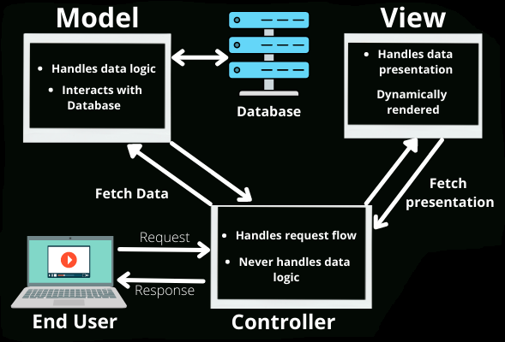
Model-View-Controller
he MVC framework includes the following 3 components: Model, View, Controller.

Slide 11
Model-View-Controller
Controller:
The controller is the component that enables the interconnection between the views and the model so it acts as an intermediary.
The controller doesn’t have to worry about handling data logic, it just tells the model what to do.
It process all the business logic and incoming requests, manipulate data using the Model component and interact with the View to render the final output.

Slide 12
Model-View-Controller
View:
The View component is used for all the UI logic of the application.
It generates a user interface for the user.
Views are created by the data which is collected by the model component but these data aren’t taken directly but through the controller.
It only interacts with the controller.

Slide 13
Model-View-Controller
Model:
The Model component corresponds to all the data-related logic that the user works with.
This can represent either the data that is being transferred between the View and Controller components or any other business logic-related data.
It can add or retrieve data from the database.
It responds to the controller’s request because the controller can’t interact with the database by itself.
The model interacts with the database and gives the required data back to the controller.

Slide 14
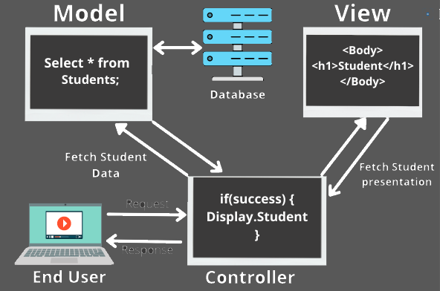
Model-View-Controller
Example

Slide 15
Model-View-Controller
Example
The model would query the database for the list of all students and then return that list back to the controller.
If the response back from the model was successful, then the controller would ask the view associated with students to return a presentation of the list of students.
This view would take the list of students from the controller and render the list into HTML that can be used by the browser.

Slide 16
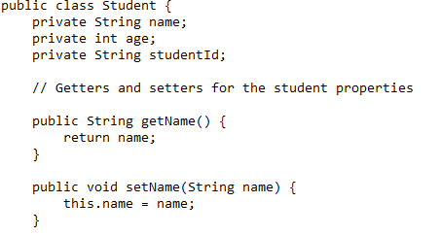
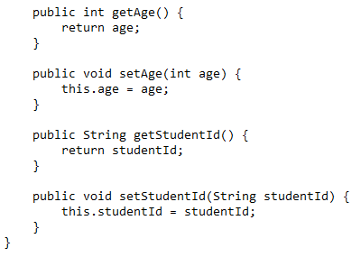
Model-View-Controller
Example: Student Management System
Model: The Model represents the data and business logic of the application. In this case, we'll have a "Student" model that encapsulates information about a student.

Slide 17
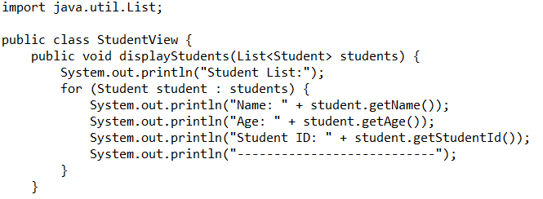
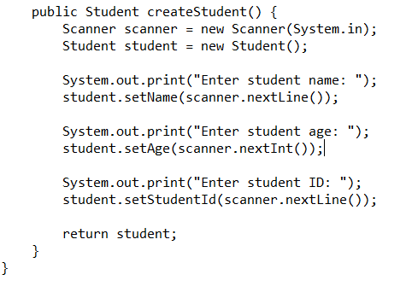
Model-View-Controller
Example: Student Management System
View: The View is responsible for rendering the user interface and presenting the data to the user. In our example, we'll have a simple command-line interface to interact with the student management system.

Slide 18
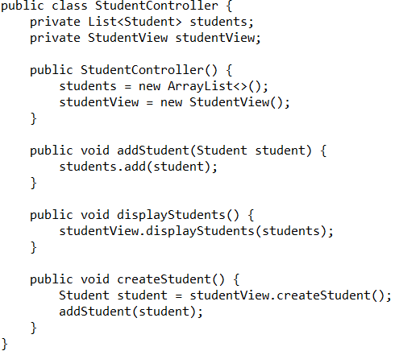
Model-View-Controller
Example: Student Management System
Controller: The Controller acts as an intermediary between the Model and the View. It receives input from the user via the View, invokes the appropriate methods on the Model, and updates the View with the student information.

Slide 19
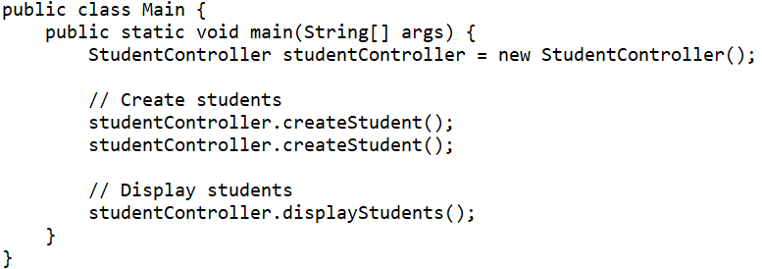
Model-View-Controller
Example: Student Management System
Usage: Here's how you would use the MVC components in a simple example:

